Slide 1
Globber Blogger
An Interactive Blog Website

Slide 2
Created by
Name- Riddhi Gupta
Roll no.- 2110991152
Group-3

Slide 3
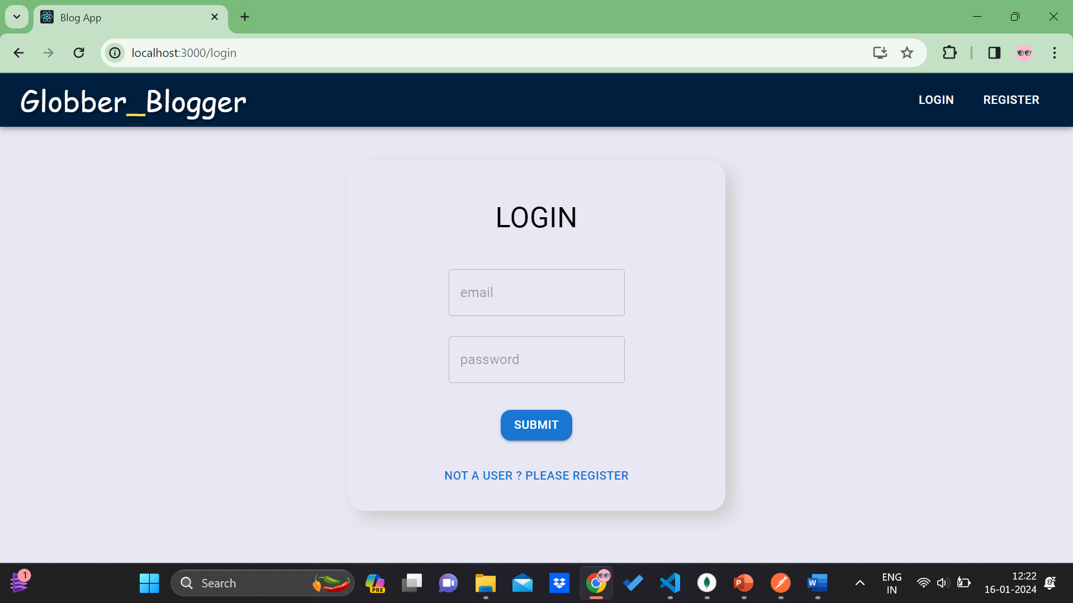
Login page

Slide 4
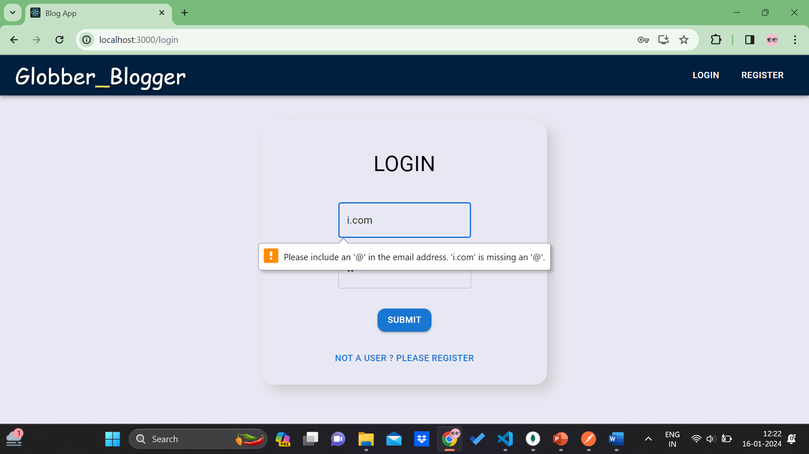
Login page- User Authentication

Slide 5
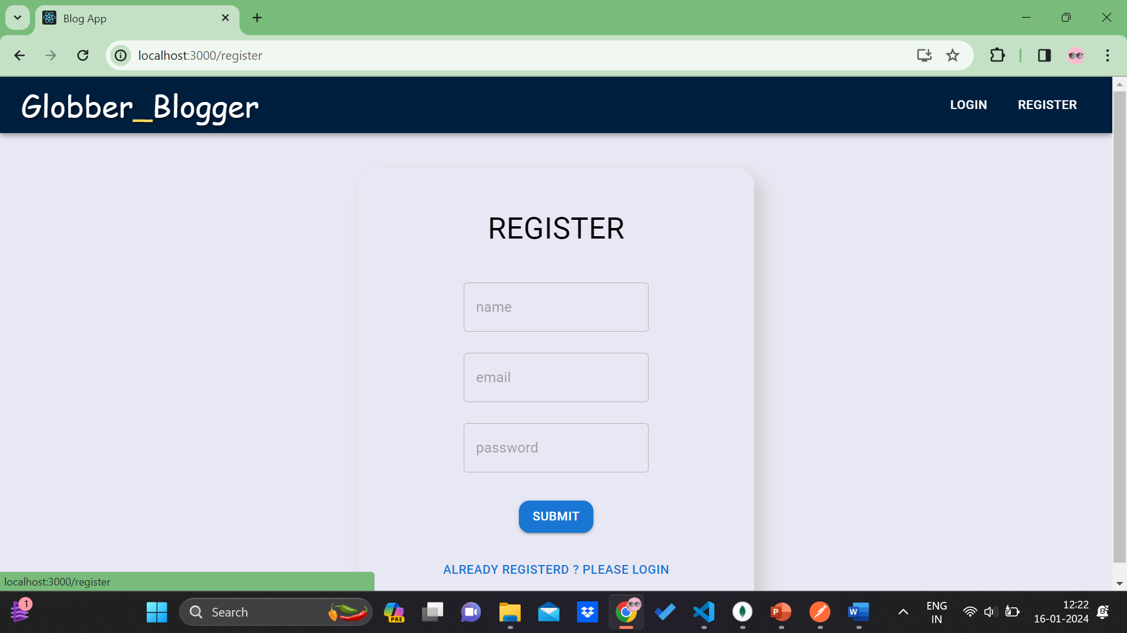
register

Slide 6
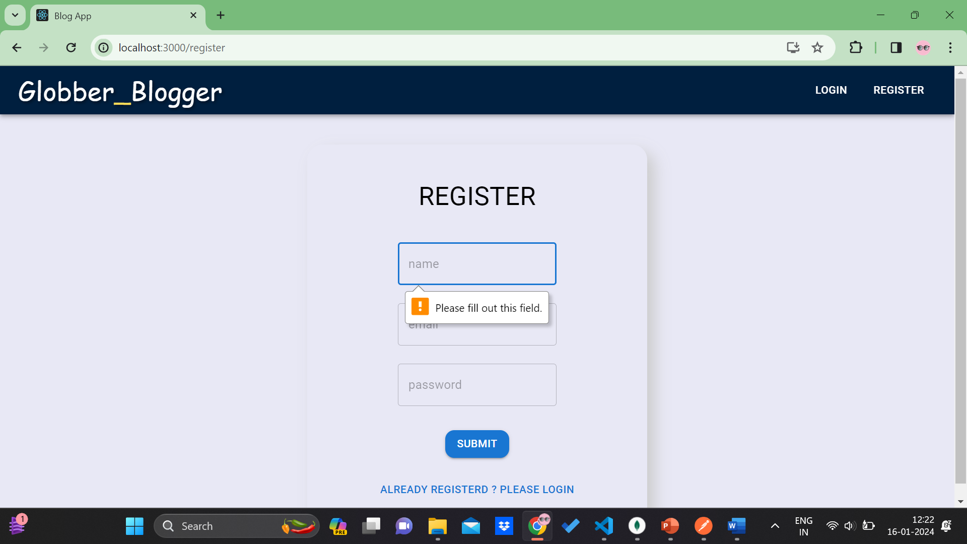
Register- user authentication

Slide 7
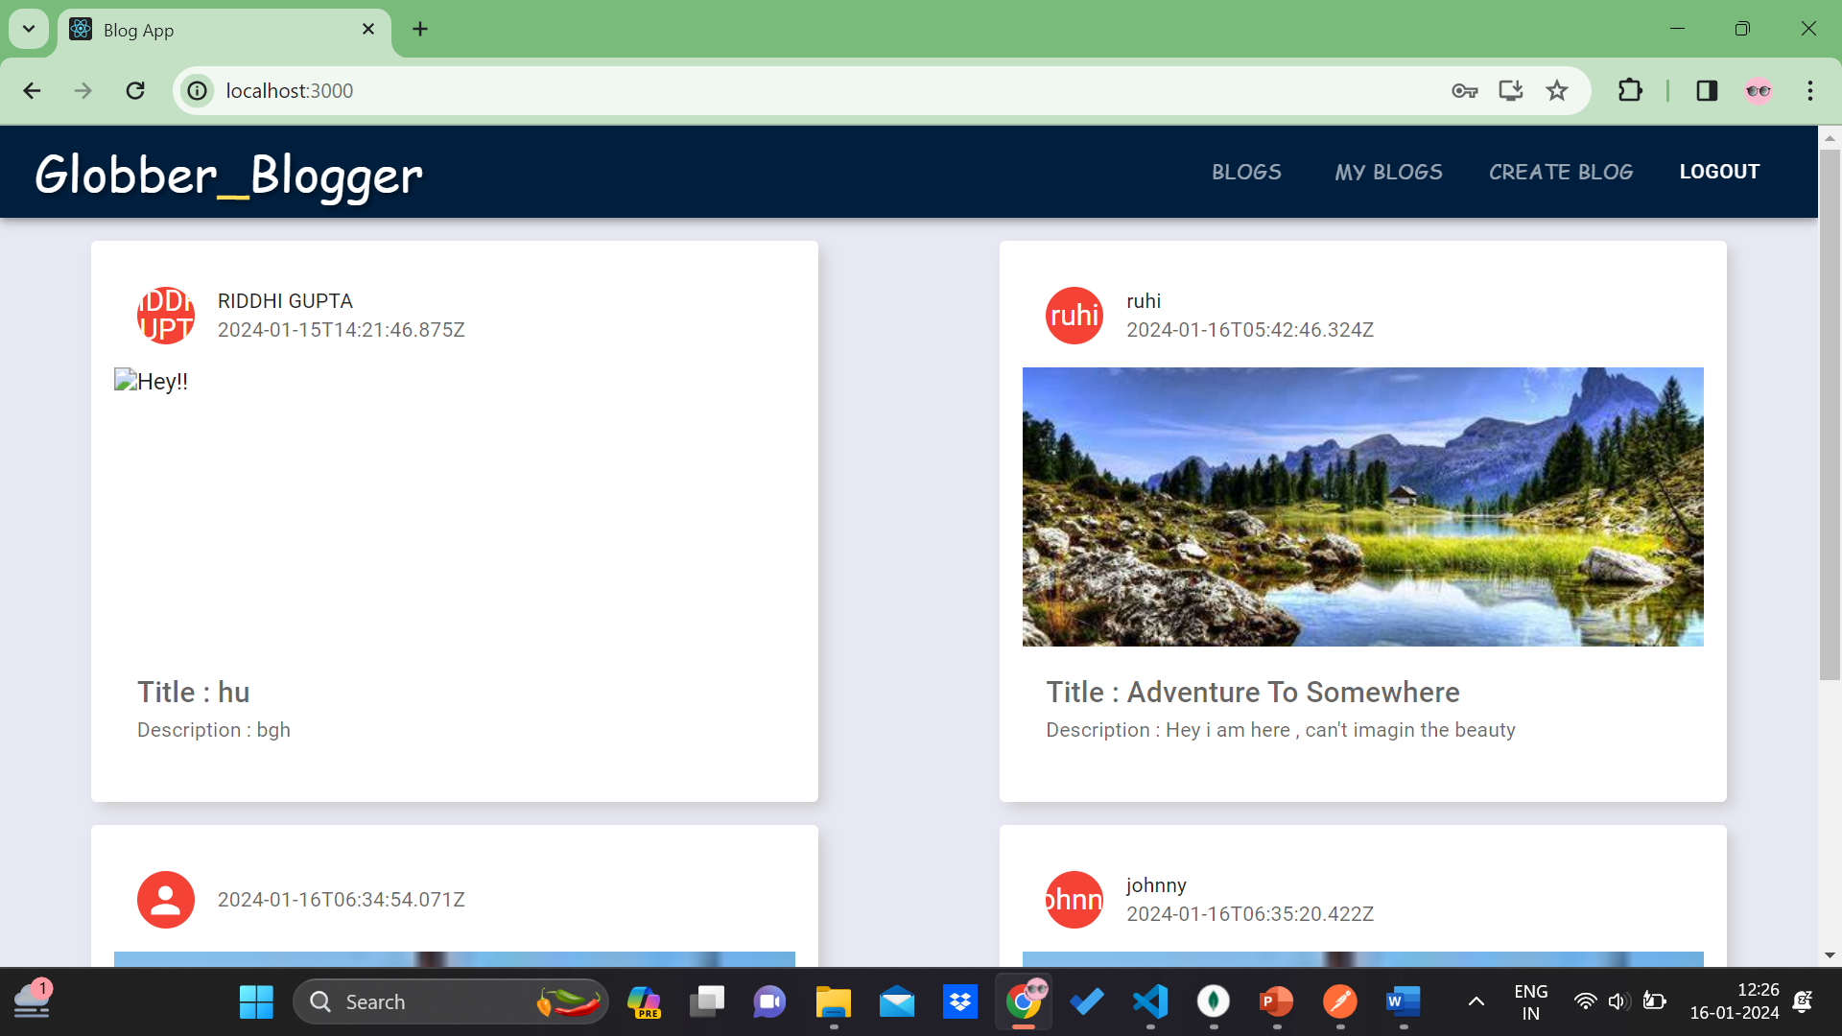
blogs page

Slide 8
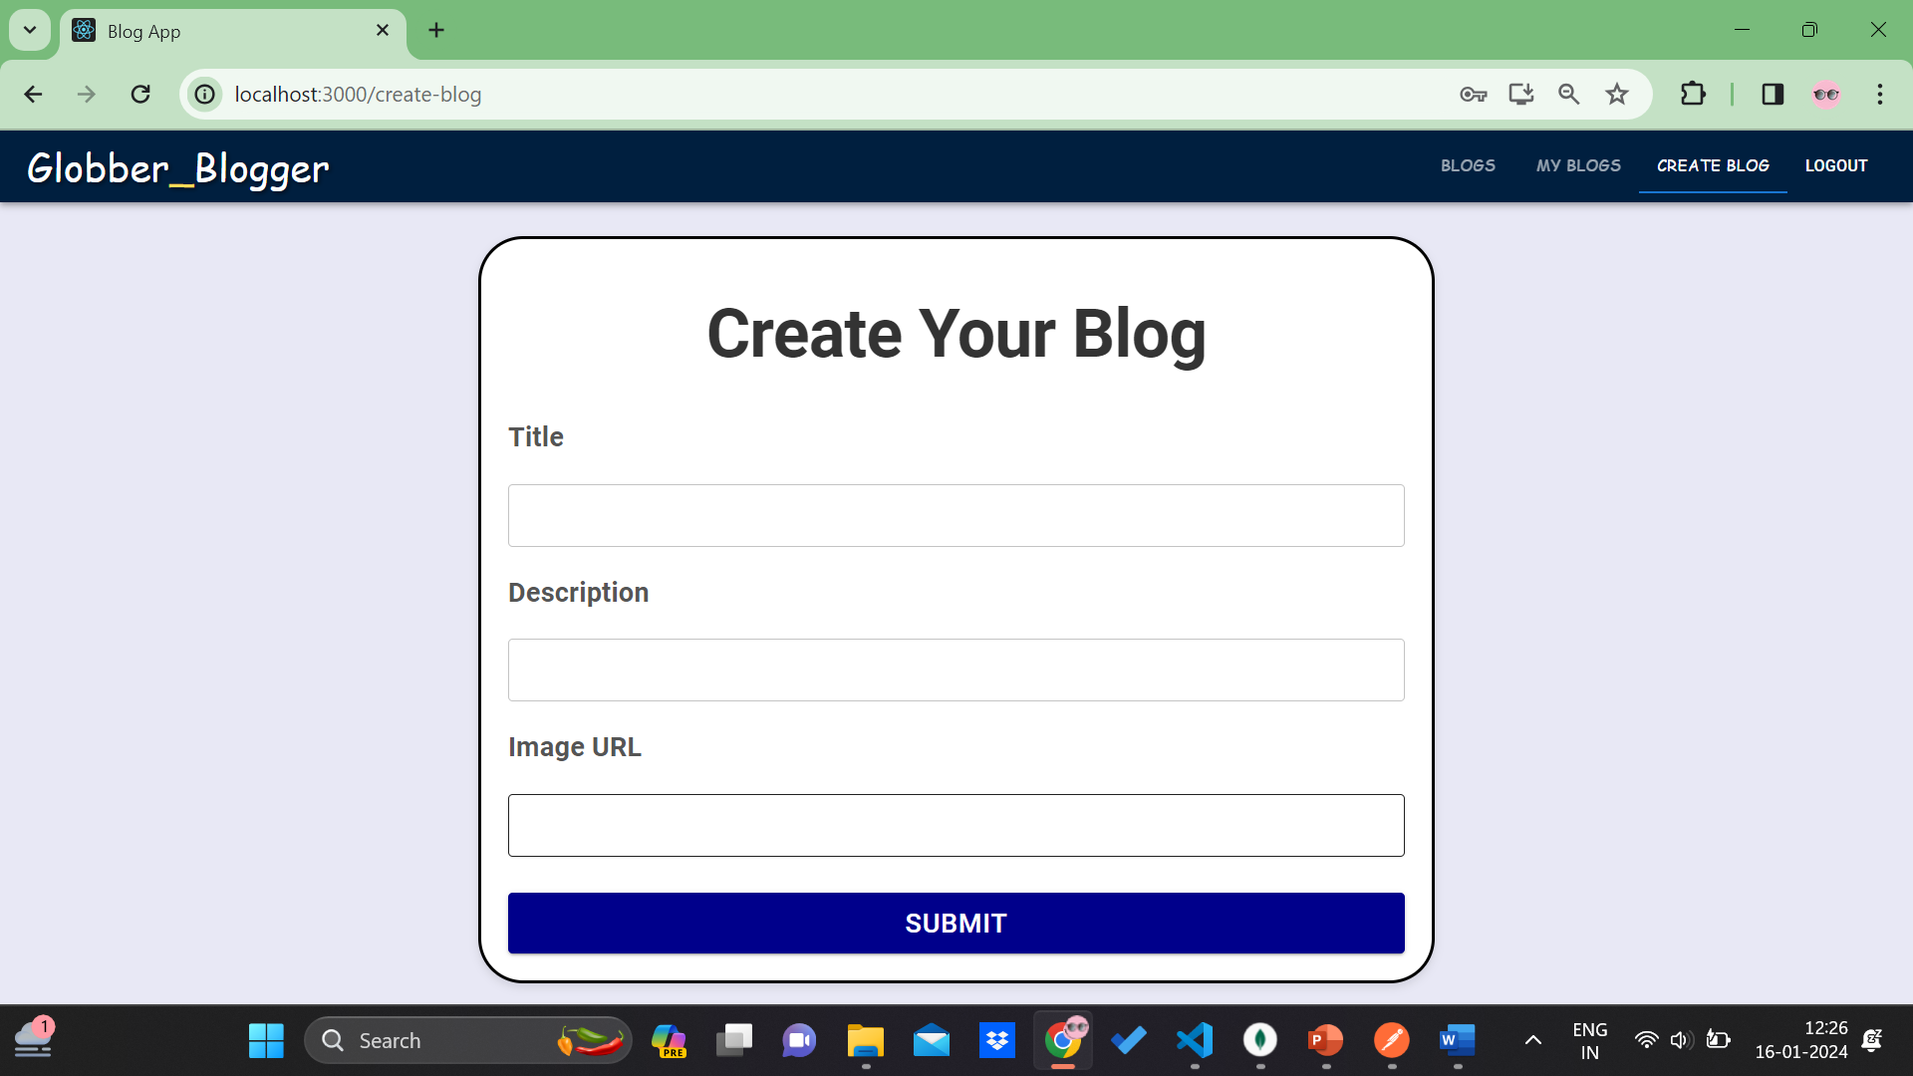
Create blog page

Slide 9
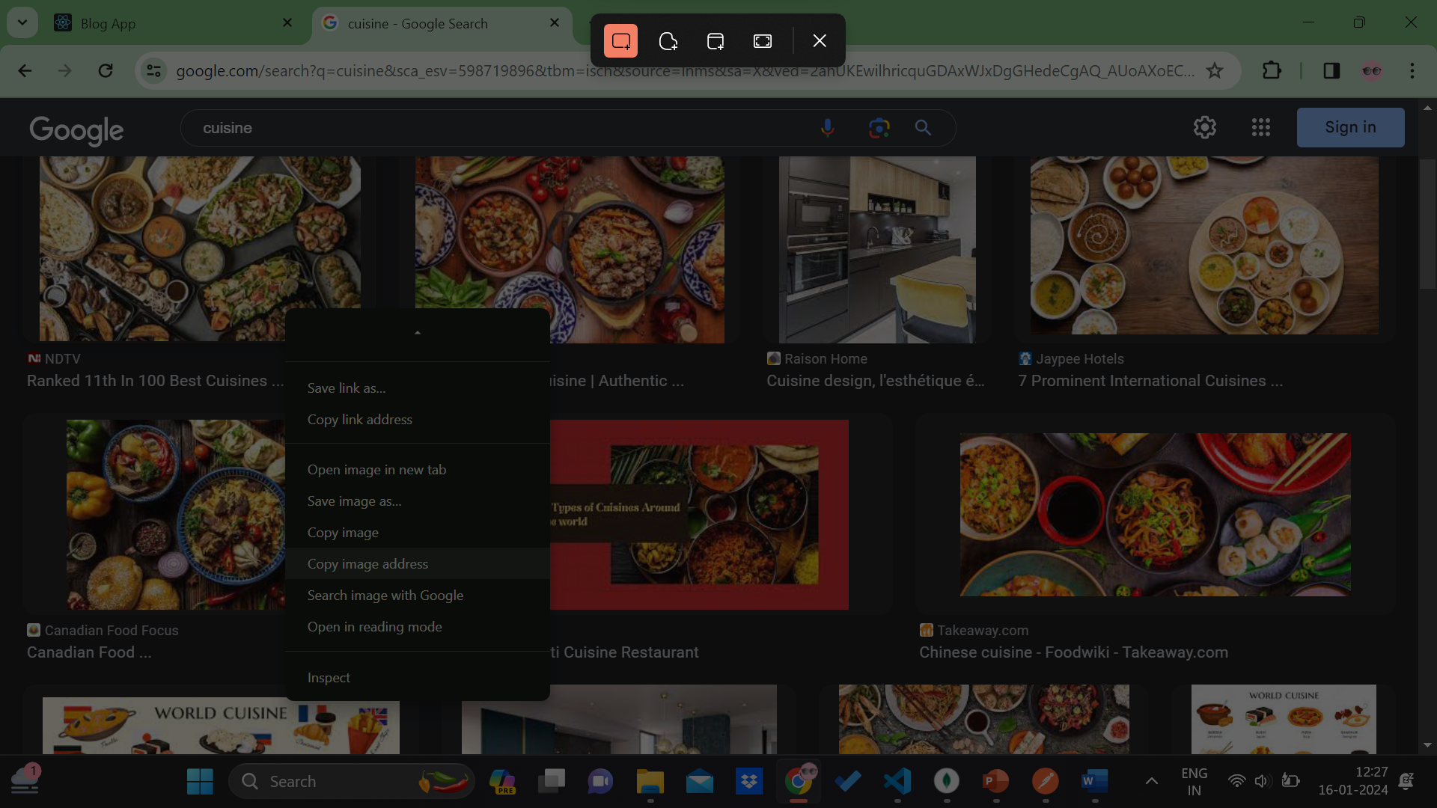
Adding photo urls to blog

Slide 10
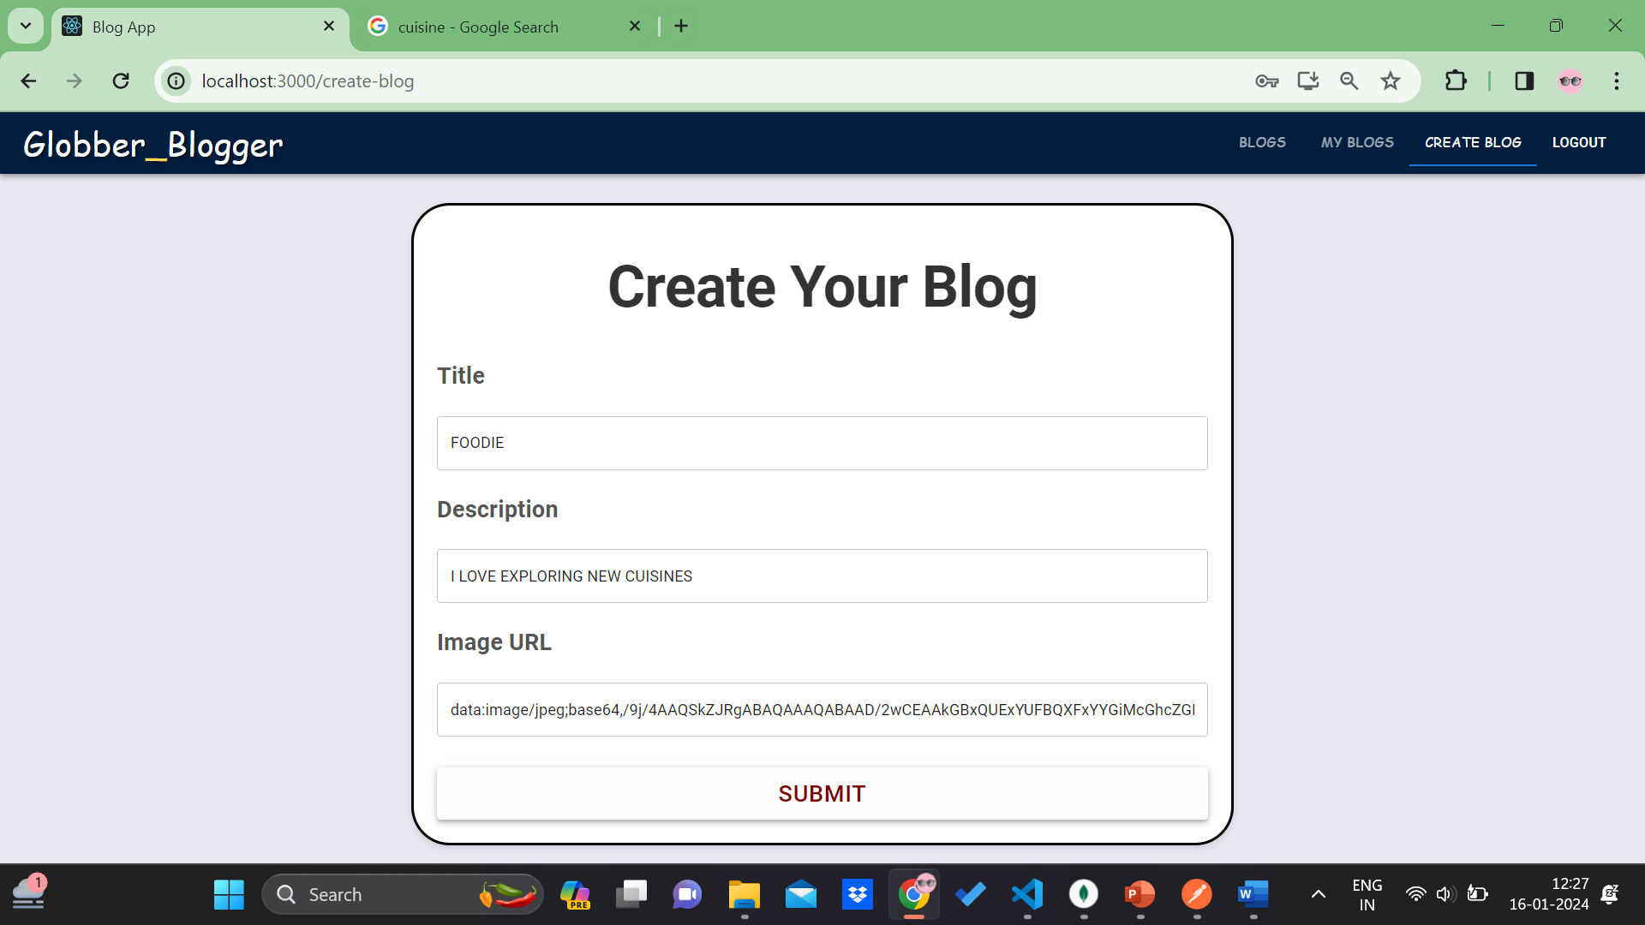
Create a blog

Slide 11
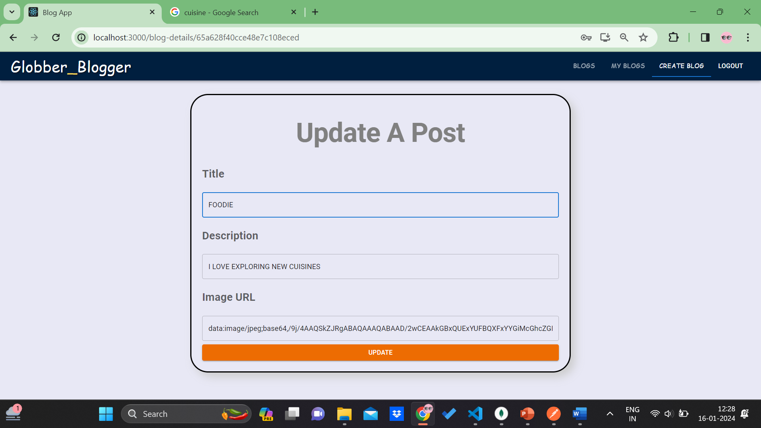
Update a blog

Slide 12
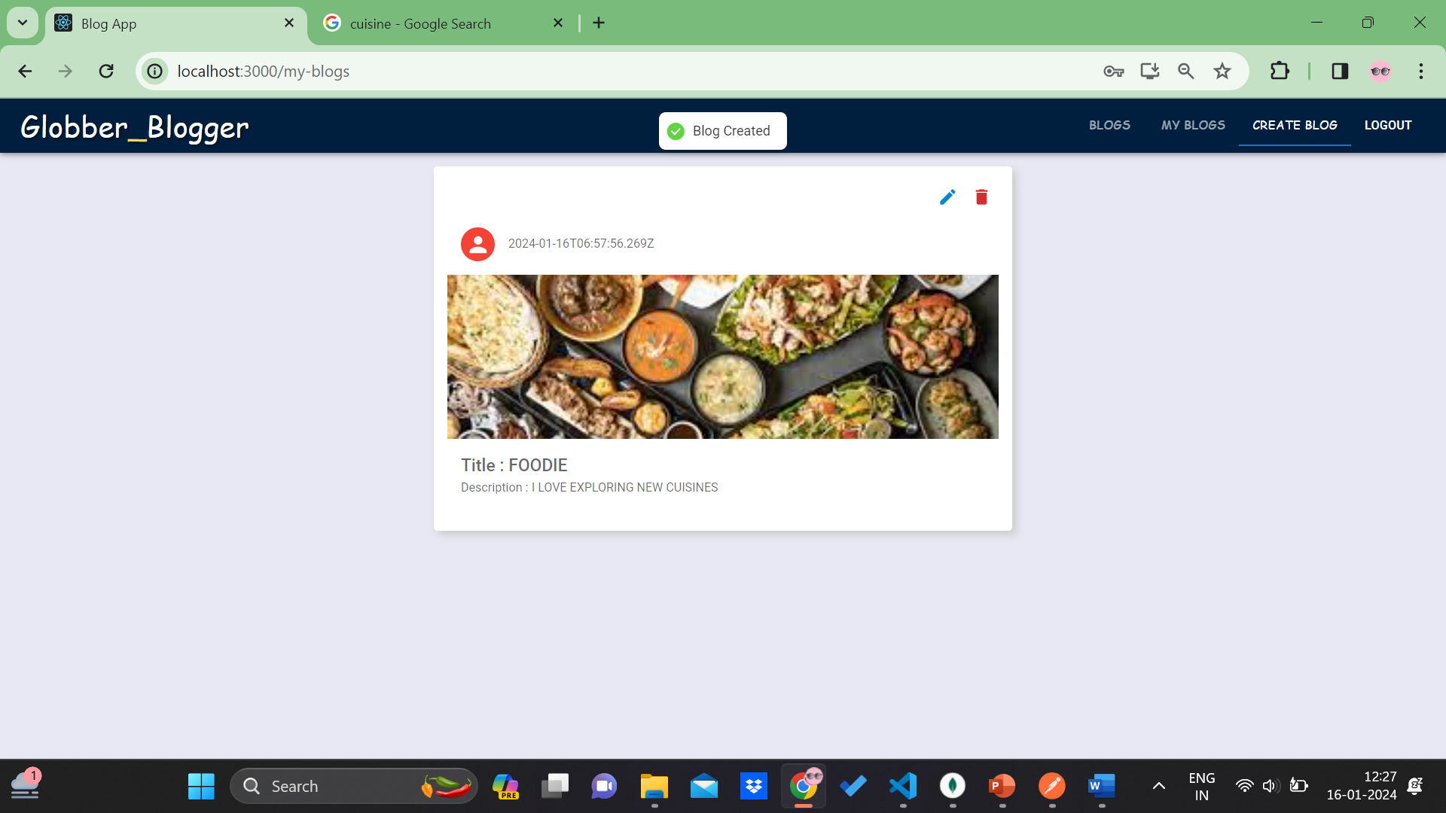
My blogs

Slide 13
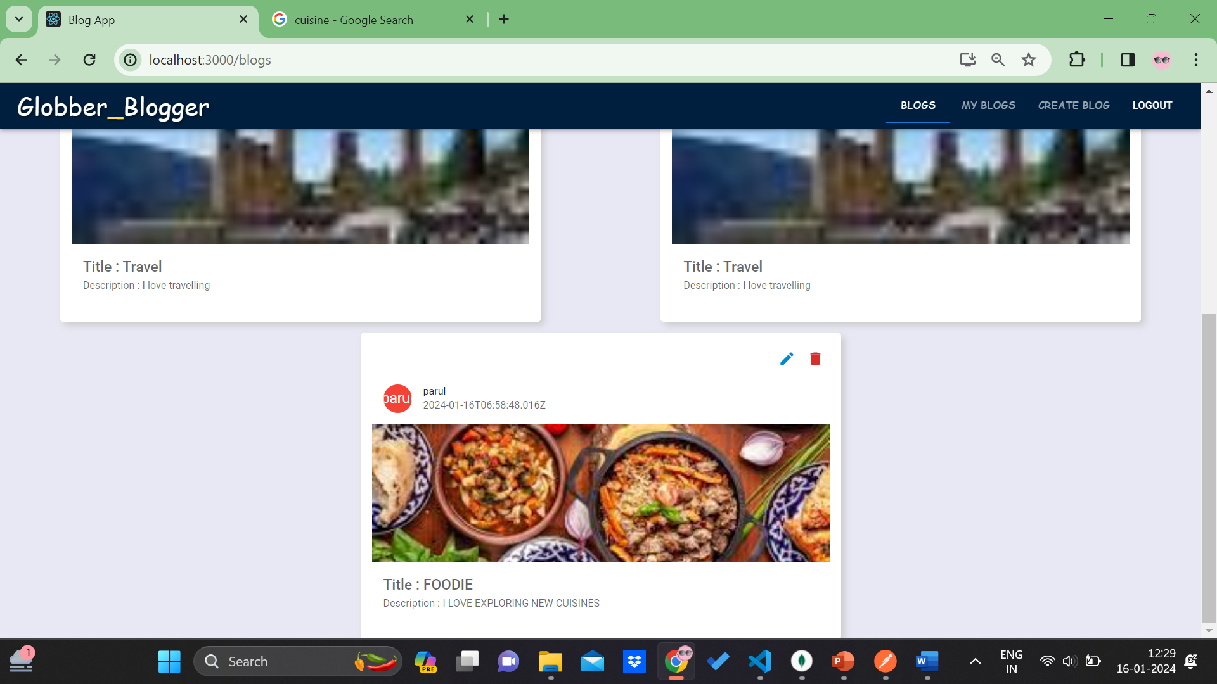
All blogs updated

Slide 14
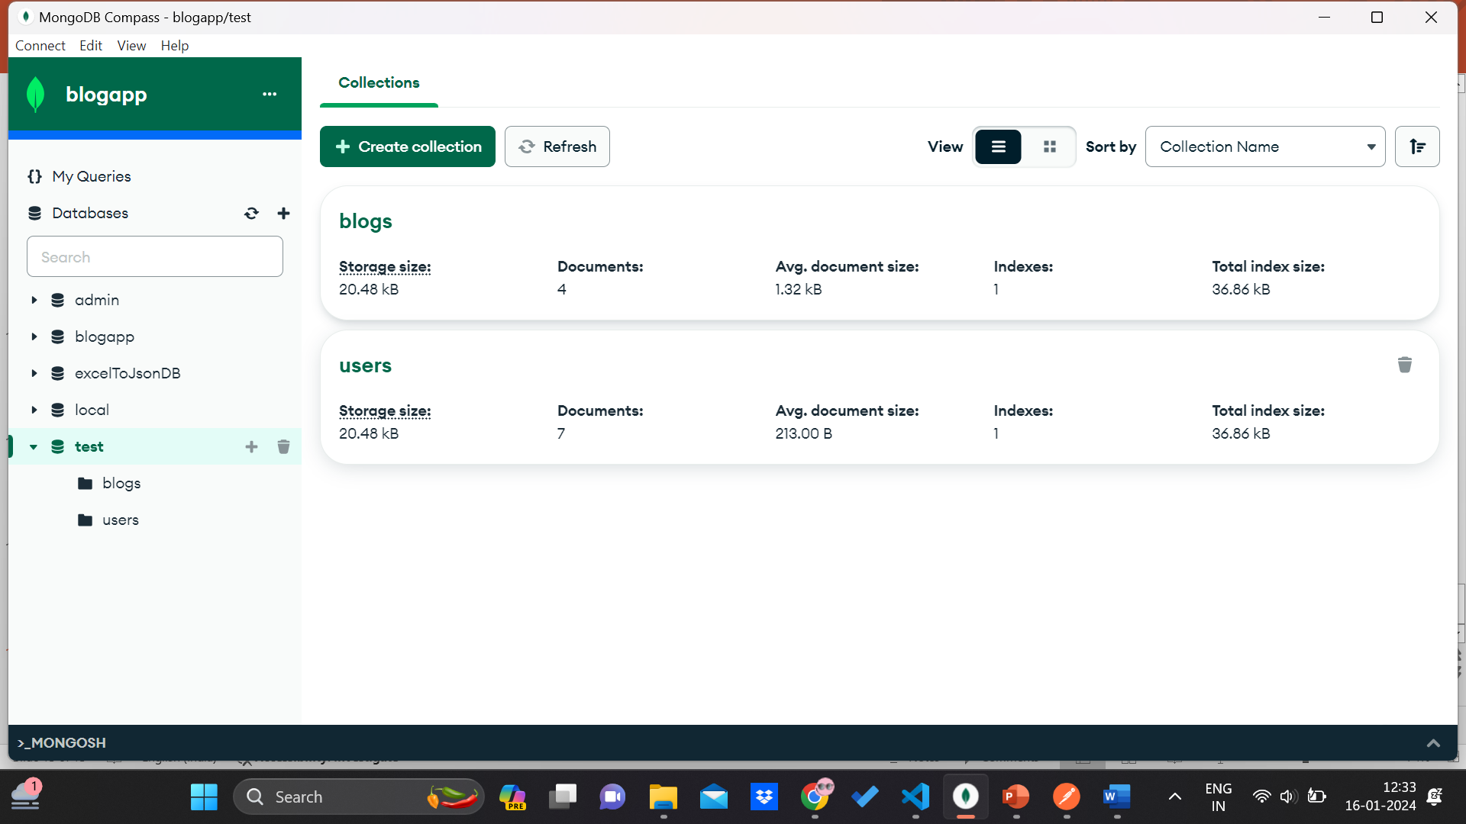
Working in mongodb compass

Slide 15
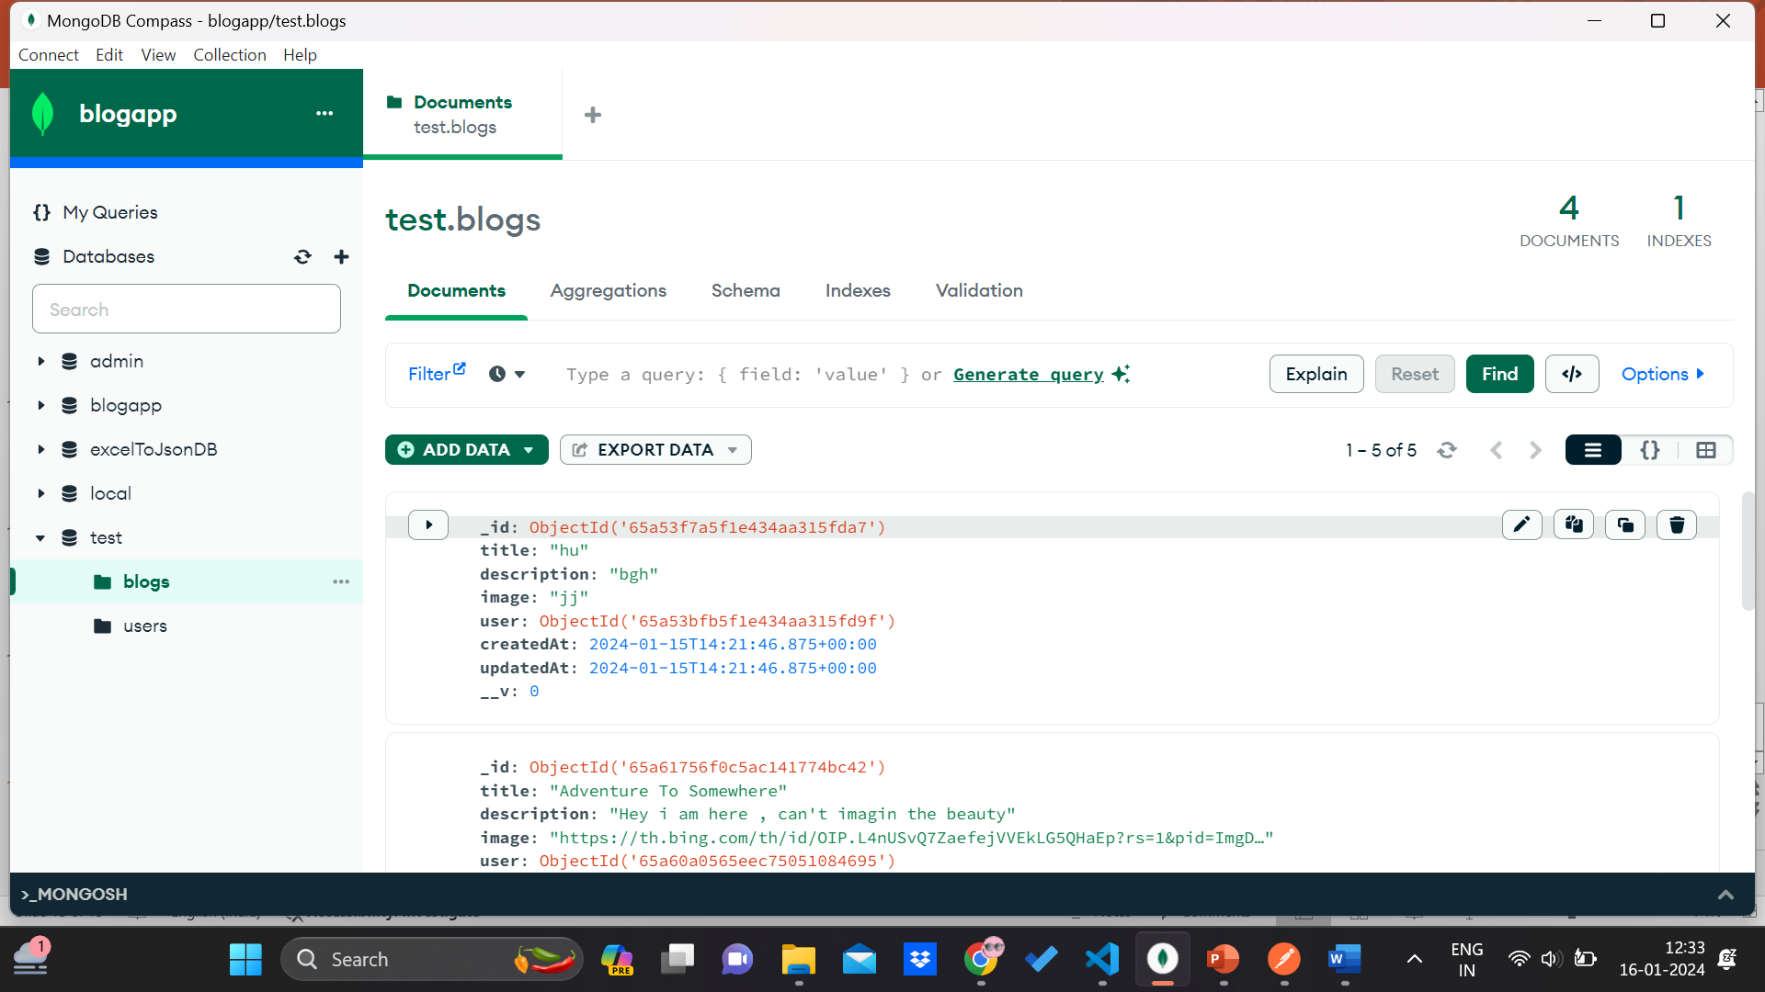
Working in mongodb

Slide 16
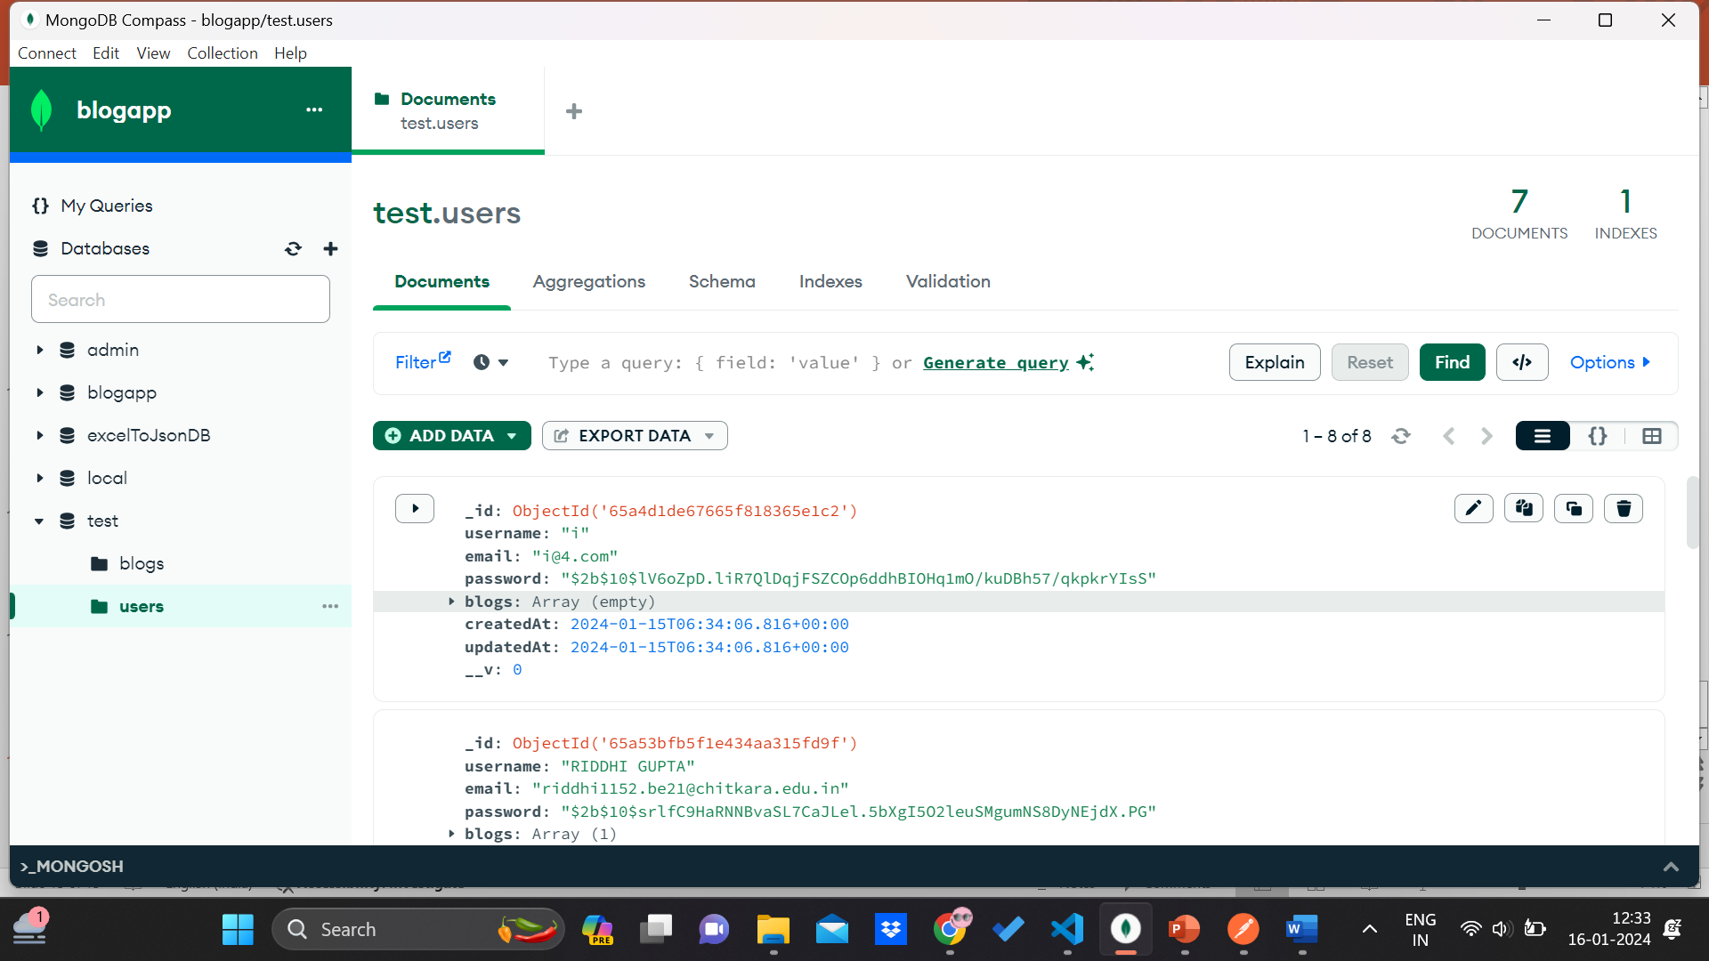
Working in mongodb

Slide 17
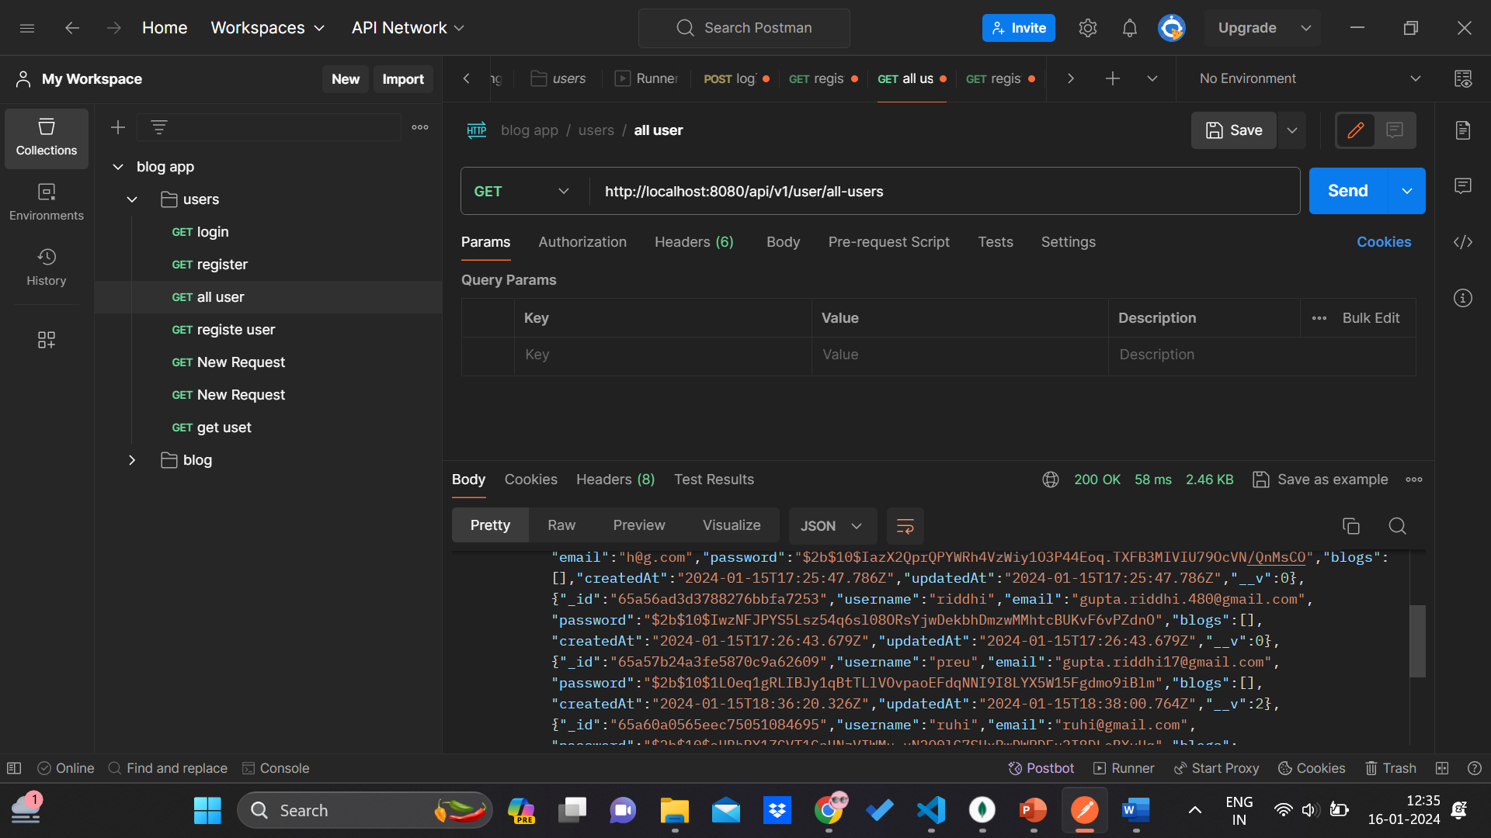
Usage of compass to get or post

Slide 18
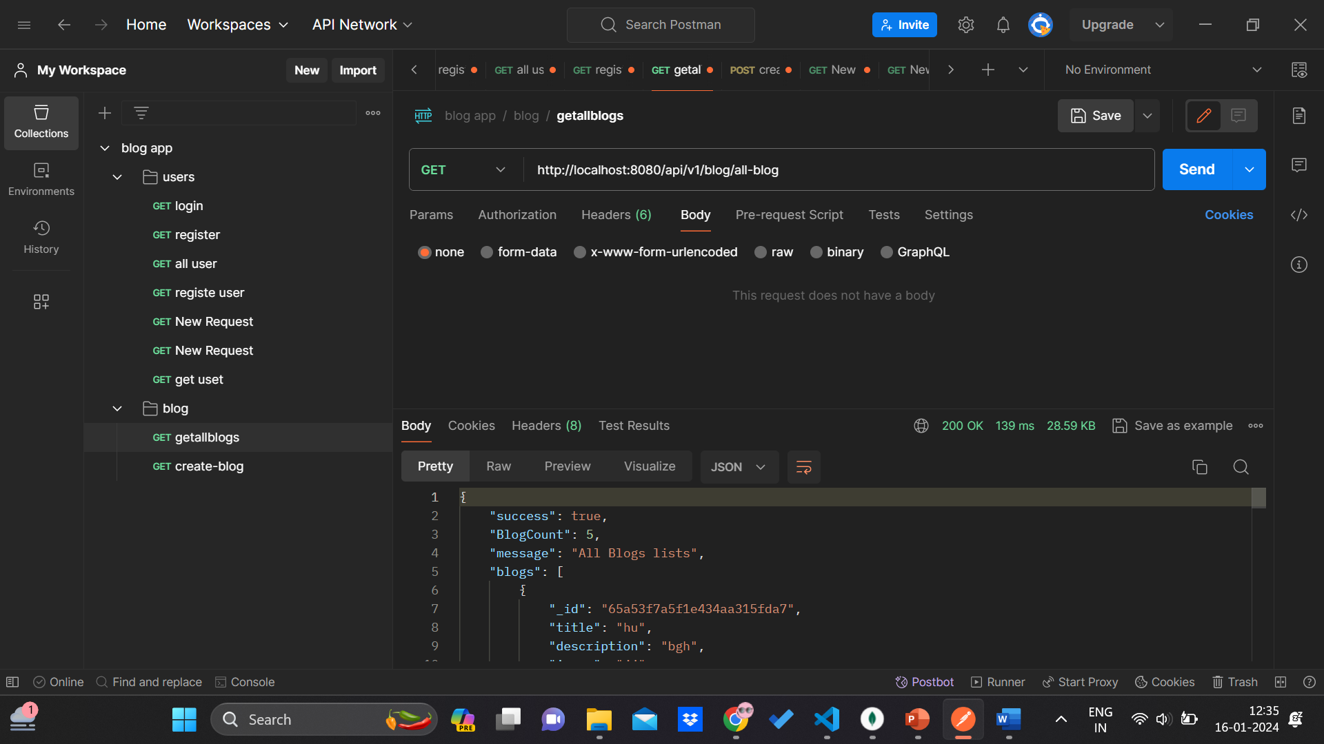
Usage of postman to get or post request

Slide 19

Thank you !!

